Slide 1
Mesh Networks for Simultaneous Localization and Communication
Project Proposal
Team 1961C
Notes:
Sai

Slide 2
Introduction / Objective
Sailboat Regattas
Series of competitive boat races
Mesh Network of radios
Real-time tracking, distance measurement techniques
Nodes
Self contained units including radio, antennas, and electronics
Minimum of four nodes
Base Station
One main base station, hosts web app
At least one other base station extender
Notes:
Sailboat regattas are a series of competitive boat races
Duration of each race ranges from 20 to 40 minutes, with 6 to 10 races in each regatta [13]
Real time tracking to help people at shore
Distance measurements for location of each boat

Slide 3
Key Technical Specifications
Radio Systems
Project Element | Category | Specifications
Radio Systems | Localization | Accuracy of 7 feet or better
 |  | Measurements every 3 seconds
 | Communications | Range not less than 300 feet
 |  | Adequate data transfer rate
 |  | Must be able to relay messages to other nodes as needed
 | Network | Operates with 1 to 12 nodes
 |  | Operates with as little as 1 base station + extender
Notes:
Keenan

Slide 4
Key Technical Specifications
Base Station
Project Element | Category | Specifications
Base Station | Enclosure | No larger than 10”x6”x6”, no heavier than 5 lbs
 |  | Must be mountable to a tripod
 | Antenna | Securely mounted to the enclosure (inside or out)
 | Power | Must be powerable from AC power or an internal battery
 |  | Internal battery must last 6 hours and charge in 8 hours
 | Interface | Must host a wifi network for displaying node locations
 |  | Must include settings relevant to system operation
Notes:
Keenan

Slide 5
Key Technical Specifications
Base Station Extender
Project Element | Category | Specifications
Base Station Extender | Enclosure | No larger than 8”x5”x5”, no heavier than 3 lbs
 |  | Must be mountable to a tripod
 | Antenna | Securely mounted to the enclosure (inside or out)
 | Power | Must be powerable from AC power or an internal battery
 |  | Internal battery must last 6 hours and charge in 8 hours
 | Interface | Have internal buttons/indicators as needed for operation
 |  | Be controllable from the base station
Notes:
Keenan

Slide 6
Key Technical Specifications
Node
Project Element | Category | Specifications
Node | Enclosure | No larger than 8”x5”x5”, no heavier than 3 lbs
 |  | Water resistant to a depth of 25 feet for up to 5 minutes
 | Antenna | Securely mounted to the enclosure (inside or out)
 | Power | Run for up to 4 hours and charge in less than 6 hours
 |  | Withstand temperatures between 40 °F and 130 °F
 | Interface | Have internal buttons/indicators as needed for operation
 |  | Be controllable from the base station
Notes:
KeenanKeenan

Slide 7
Design Approach and Details
Notes:
Sai

Slide 8
Radio Transceiver
Antennas
DW1000
Onboard ToF hardware
Supports communication between modules
Testing phase
DWM1000 modules (integrated antenna) with pins broken out to a breadboard
Final Development
Custom PCB integrating DW1000, RF electronics, external antenna connection
Omni-directional (node)
Loop or Dipole
Directional Antenna (base)
End-fire or Yagi-Uda
Testing phase
DWM1000 module integrated antenna
Notes:
Sai

Slide 9
Power Supply
Microcontrollers
18650 Battery (node)
Thermal and volumetric efficiency
Higher charge cycle count (~1800)
Cheaper
Sealed Lead Acid (SLA) (base)
AVR vs. ARM vs. Xtensa RISC
Library compatibility
Processing speed
Power consumption
Final Design Considerations
AVR and ARM-based microcontrollers can be integrated into the PCB
Modules from Espressif would be soldered to the PCB as is
Notes:
Sai / Kevin

Slide 10
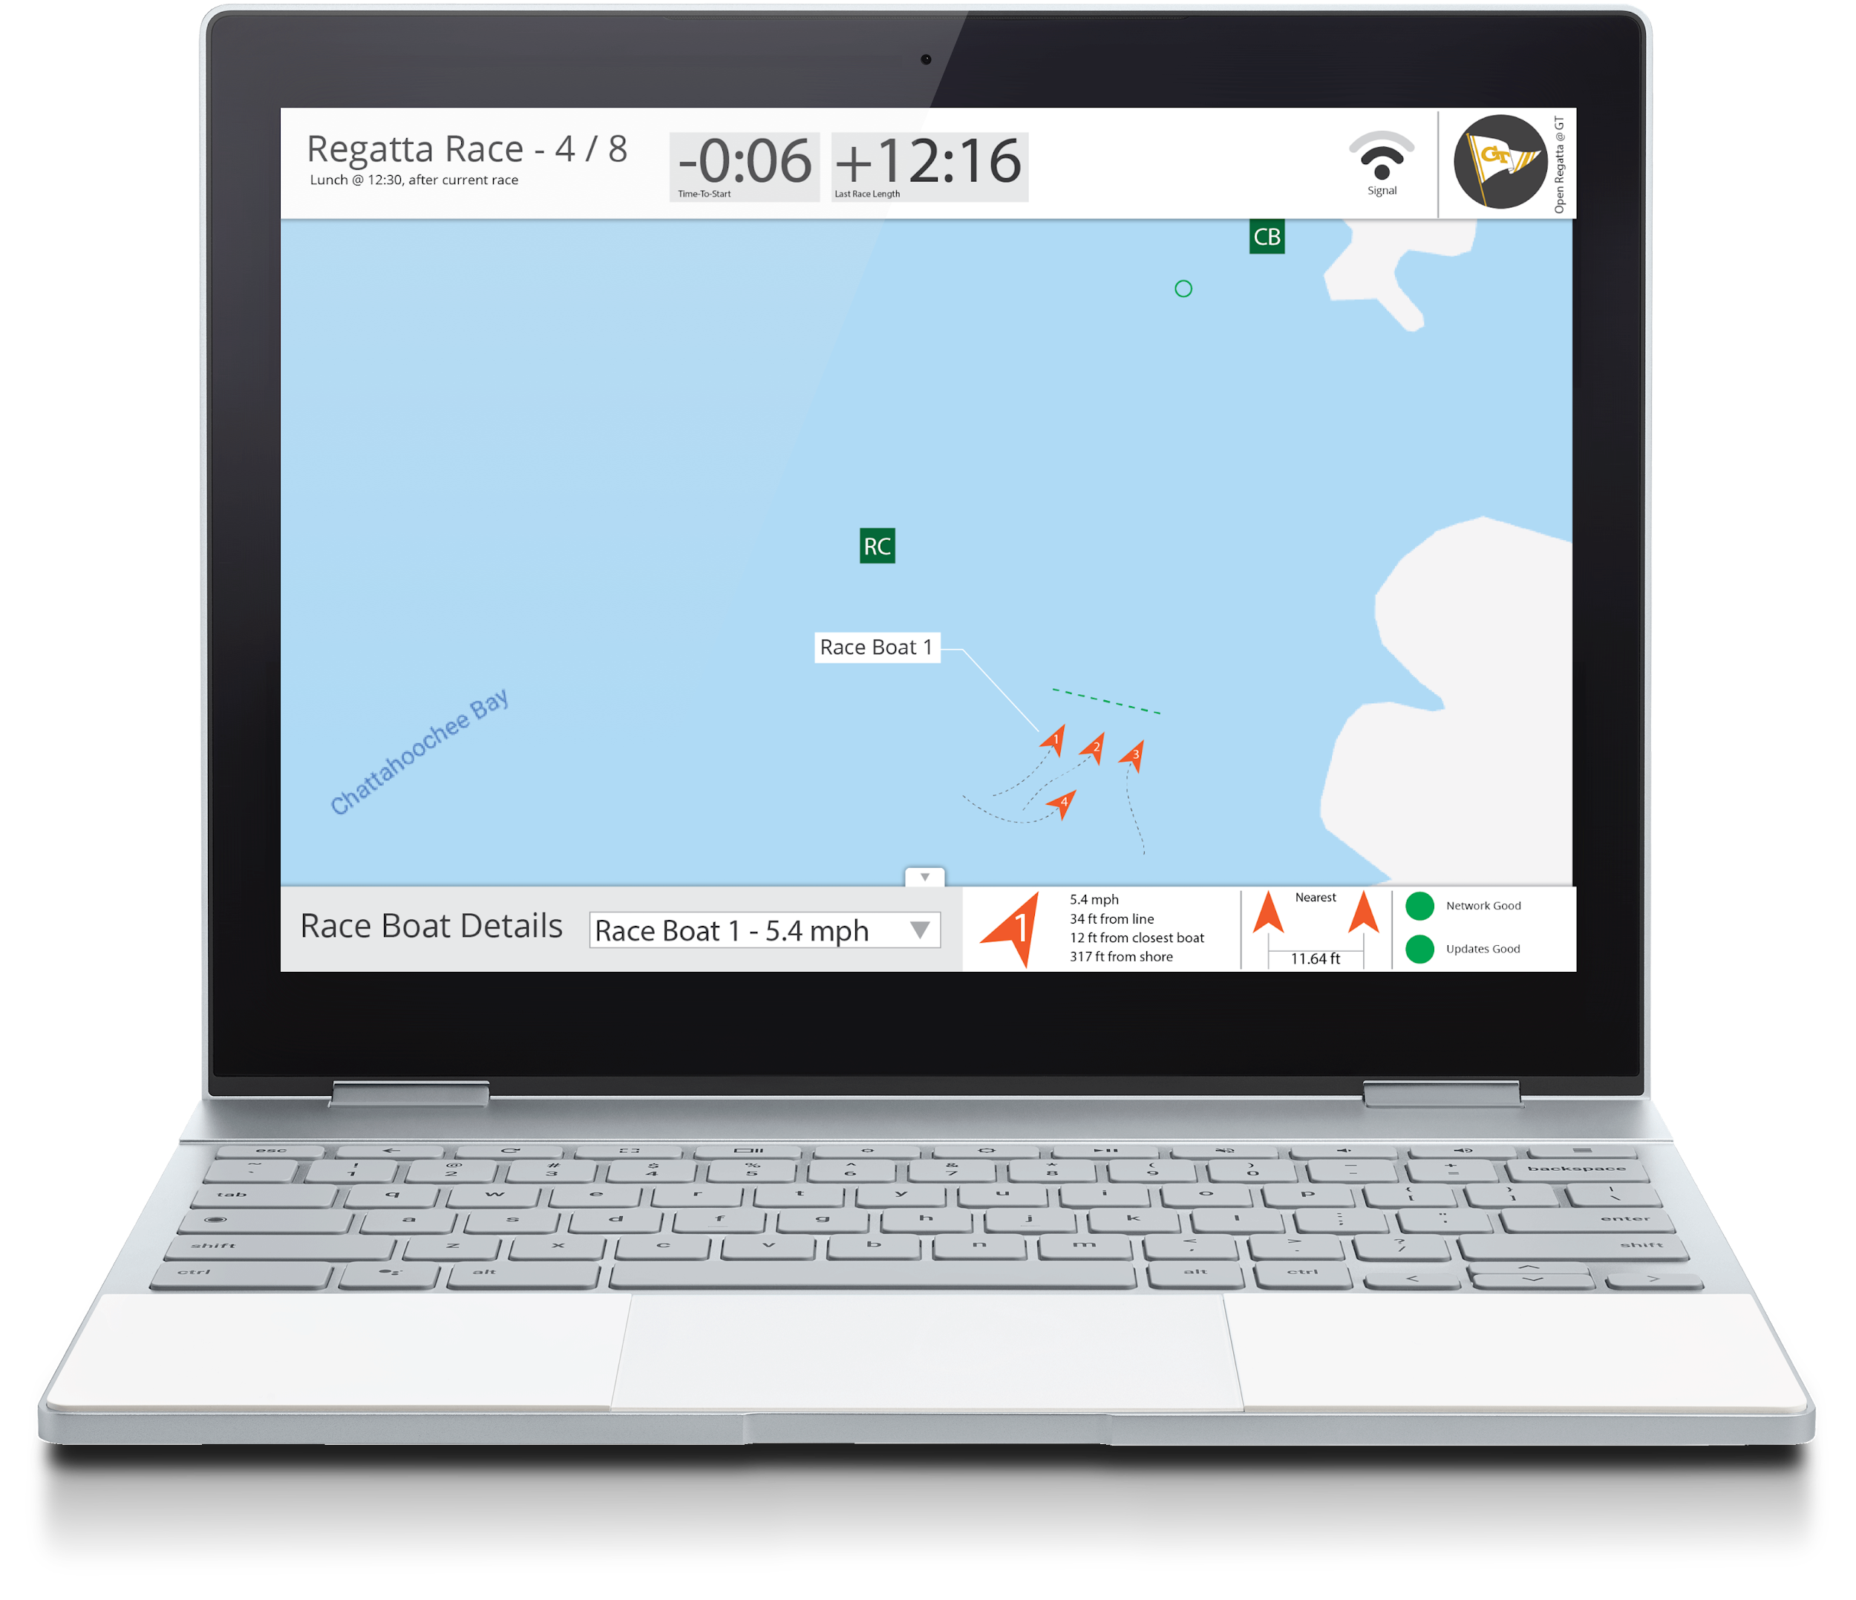
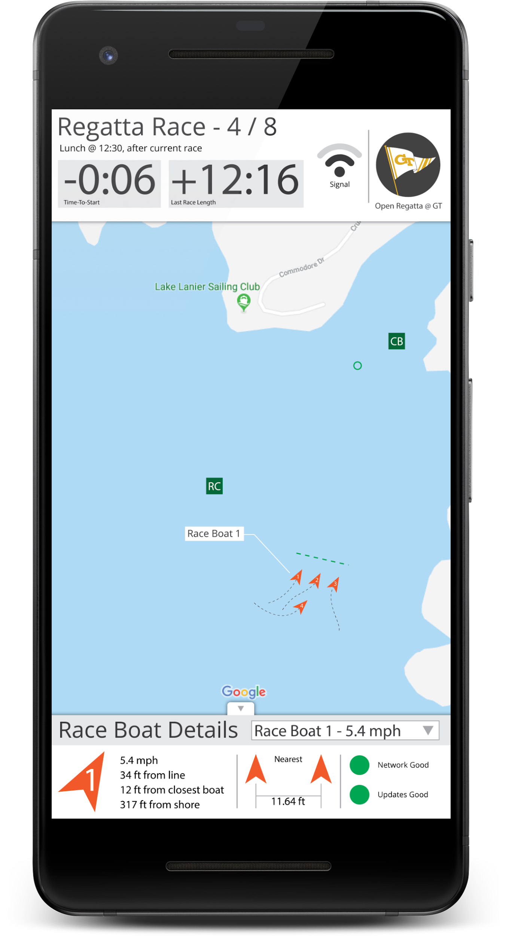
Algorithm
ToF
ToF
Algorithm
ToF
Notes:
Kevin

Slide 11
Localization
Methods
Mesh Network
Localization Area
Direct Triangulation Area
Notes:
Kevin

Slide 12
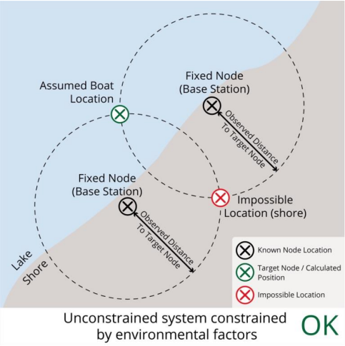
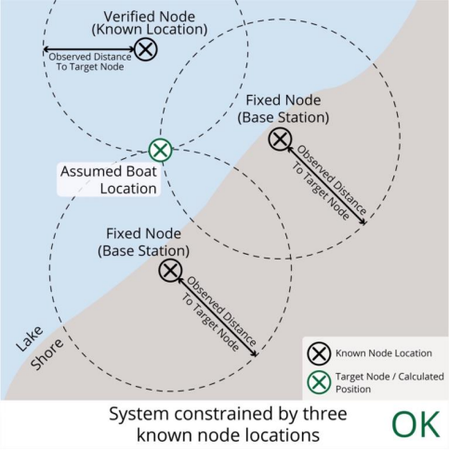
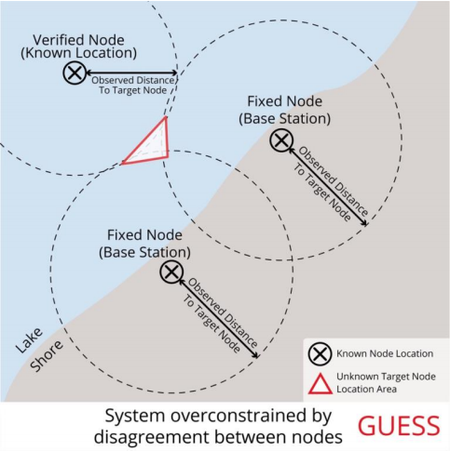
Challenge - Overconstrained Localization
Notes:
Kevin

Slide 13
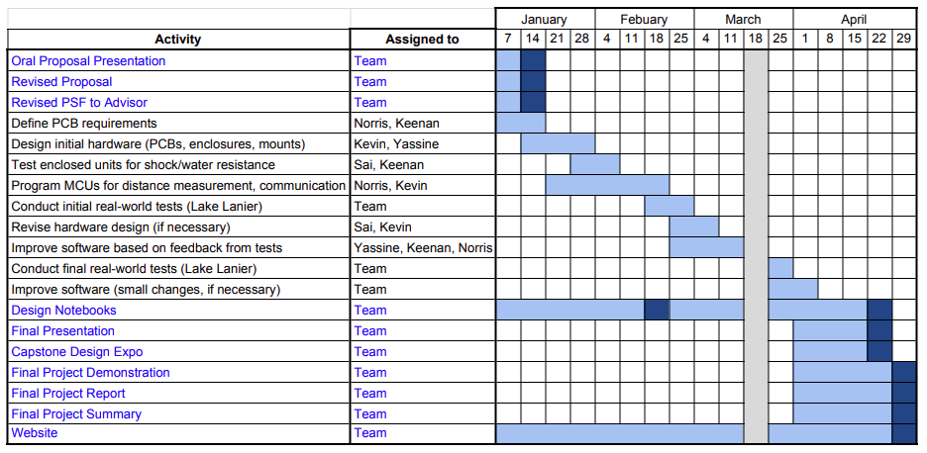
Schedule, Tasks, and Milestones
Notes:
Norris

Slide 14
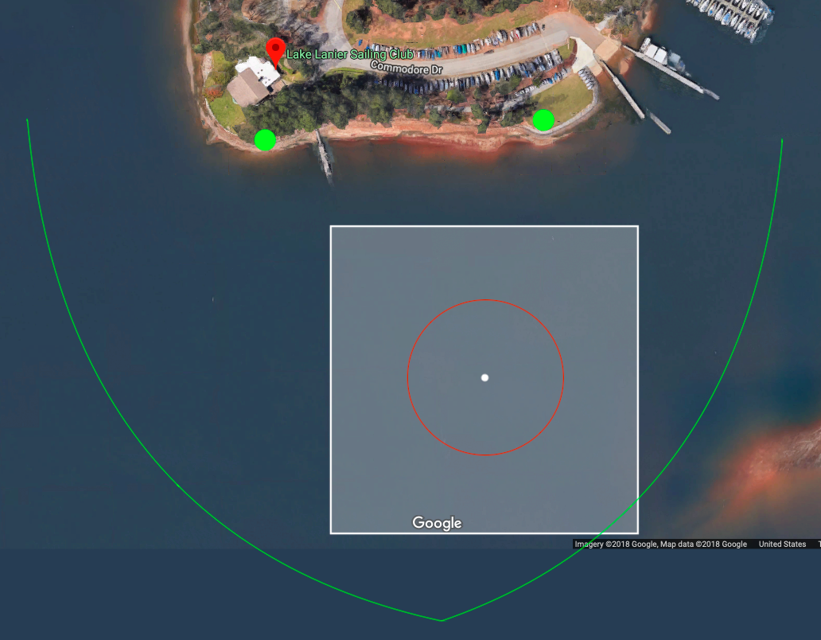
Project Demonstration
We will coordinate with the Georgia Tech Sailing Club for use of their boats
Nodes will be placed on C420 sailboats
One base station + extender pair will be placed on shore (green dots)
Notes:
Norris

Slide 15
Cost Analysis
Node
Base
Misc.
Item | Cost
Radio | $24.40
Antenna | $5.99
Microcontroller | $1.59
Power Supply | $5.00
Total | $36.98
Item | Cost
Antenna | $30.00
Microcontroller | $6.95
Power Supply | $30.00
Total | $66.95
Item | Cost
Wiring | $10.00
Packaging | $15.00
Extras | $100
System Total (4 node, 2 bases) | $406.82
Notes:
Yassine

Slide 16
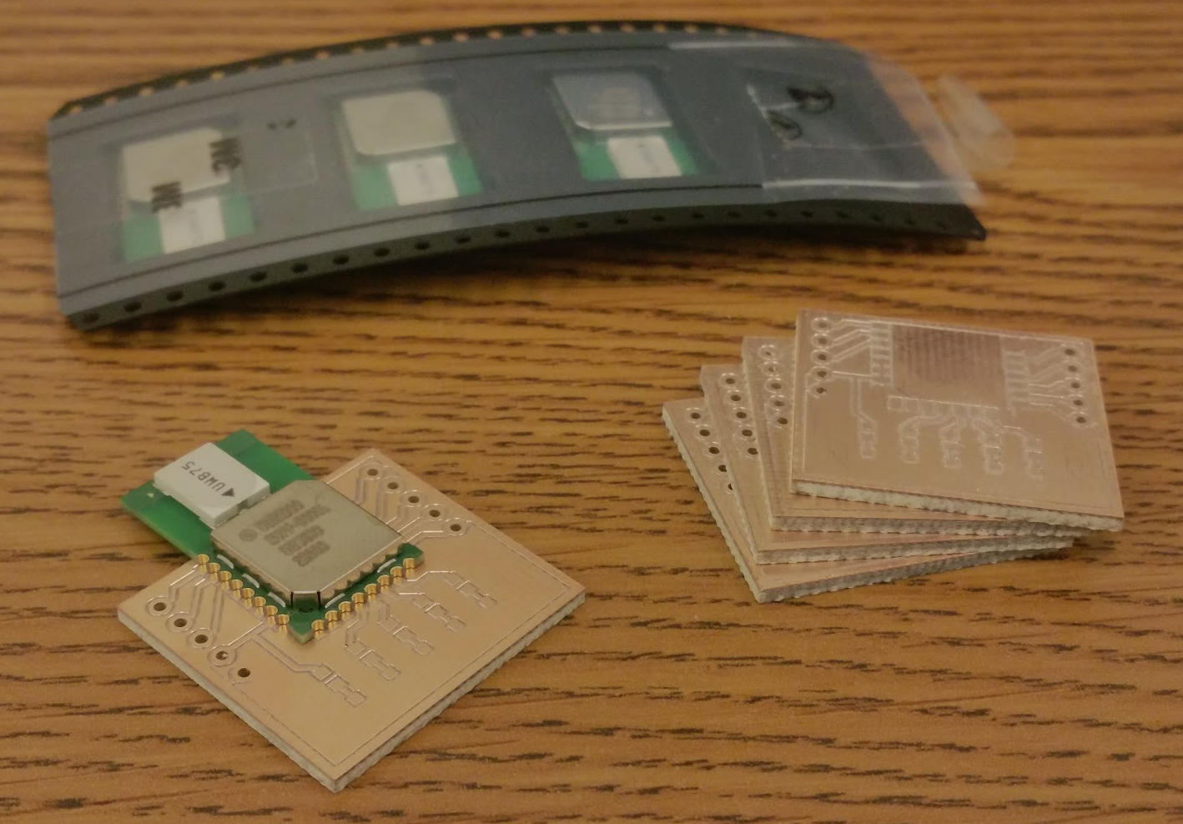
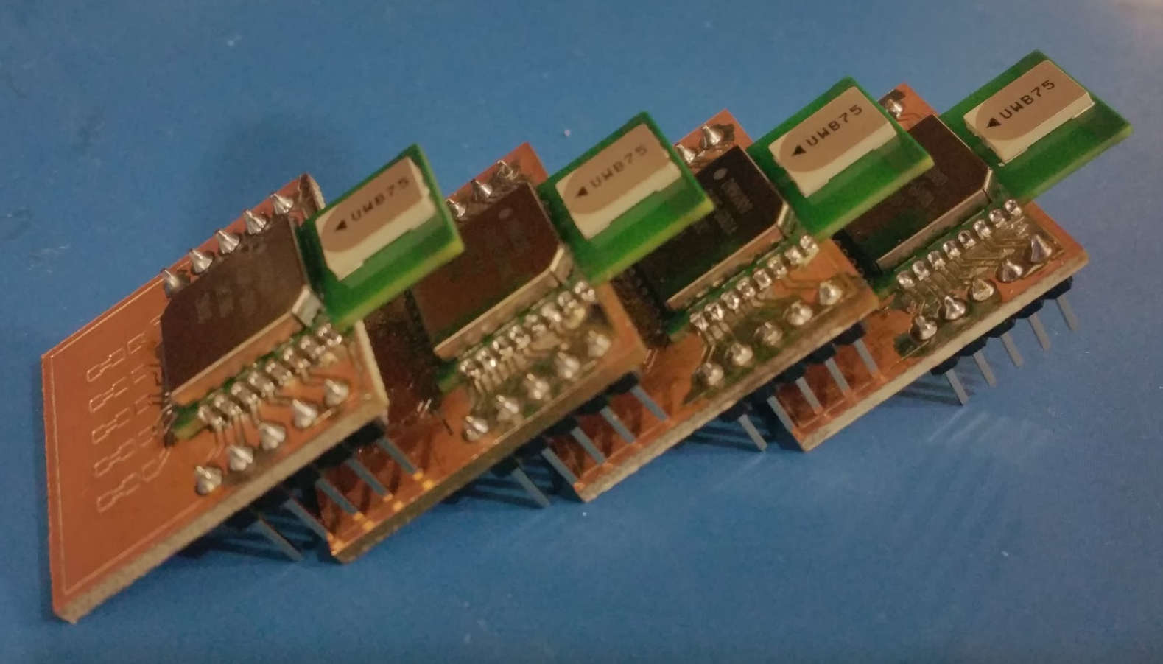
Current Status
Acquired test hardware
4x DWM1000
Various MCUs
DWM1000 Breakout PCBs
Designed and fabricated
Currently testing microcontrollers
Arduino
Teensy
ESP8266
Notes:
Yassine

Slide 17
Next Steps
Design initial hardware (PCBs, enclosures, mounts) Jan 28th
Test enclosed units for shock/water resistance Feb 2nd
Program MCUs for distance measurement, communication. Feb 18th
Conduct initial real-world tests (Lake Lanier) Feb 25th
Notes:
Yassine

Slide 18
Questions?

